Slide 1
Review on the top 50 Youtube channels
Which factors are making Youtube channels successful in 2024 ?

Slide 2
Summary
- Data used for this analysis
- General analysis :
- Content analysis
- Subscribers count analysis
- Category dominance subscribers count-wise
- Geographic and language distribution
- Language popularity
- Language dominance per category
- Top channel per region
- Advanced analysis :
- Trends analysis
- Country insights analysis
- Subscribers distribution between Brand and non brand channels
- Influence of brand channels in categories

Slide 3
Data used for this analysis
- This dataset contains data from early 2024.
- Name : The name of the channel.
- Brand channel : The channel is tied to a brand, meaning it’s content is managed by a specific team from a business, company, or an individual focusing on only one « brand ». These channels mostly present the brand itself, products or an organization with videos like video presentations, tutorials, « A day in X organization » type of video etc.
- Non brand channel : The channel is a personal channel, meaning not tied to a company but an individual or a small team working on personnel projects. It can be sponsored or having some merchandising but the fact that this started as a personal project makes the channel non brand.
- Subscribers (in millions) : Total amount of subscribers, in millions
- Primary language : The original language of the channel (original channel is taken into account, not the translation channels)
- Category : Channel's category (music, entertainment, gaming and such)
- Country : Channel's country of origin (or creator's channel origin)

Slide 4
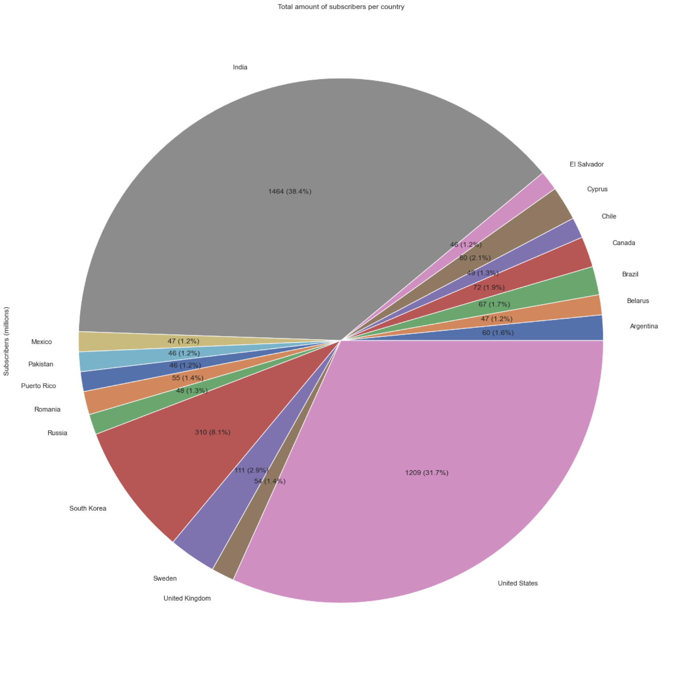
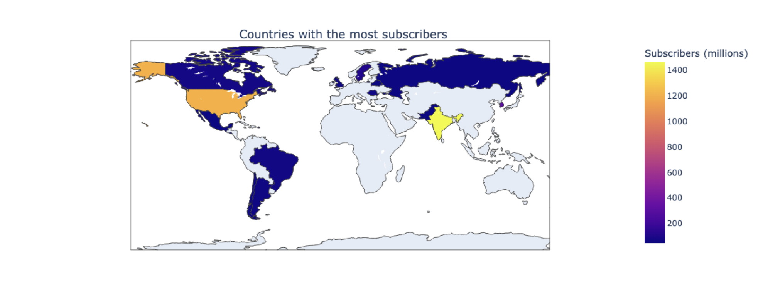
General Analysis
Subscriber count analysis :
- India and the USA have significantly more subscribers than other countries. This can be explained by them being the first and third most populated countries in the world (China is second but uses another platform, Youku, not affiliated with YouTube).
- We can witness here an unbalanced dispatching, The USA and India cover two-thirds of the total amount of subscribers (38.4% and 31.7%, a total of 70.1 %) while the country with the third largest amount of subscribers, South Korea, only has 8.1%.

Slide 5
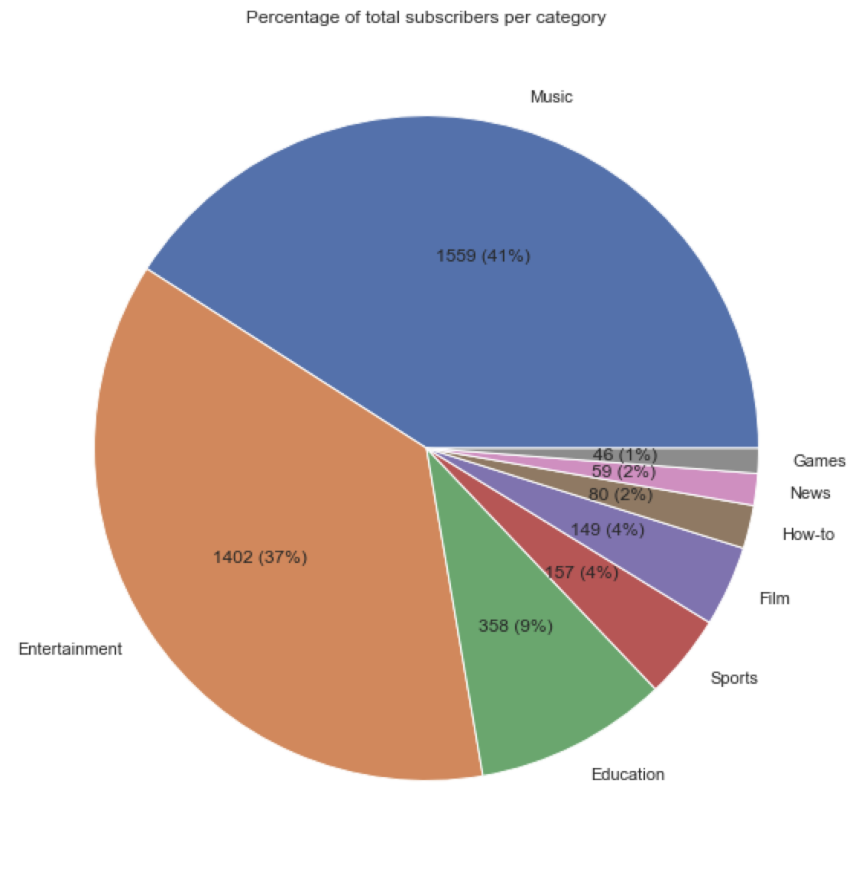
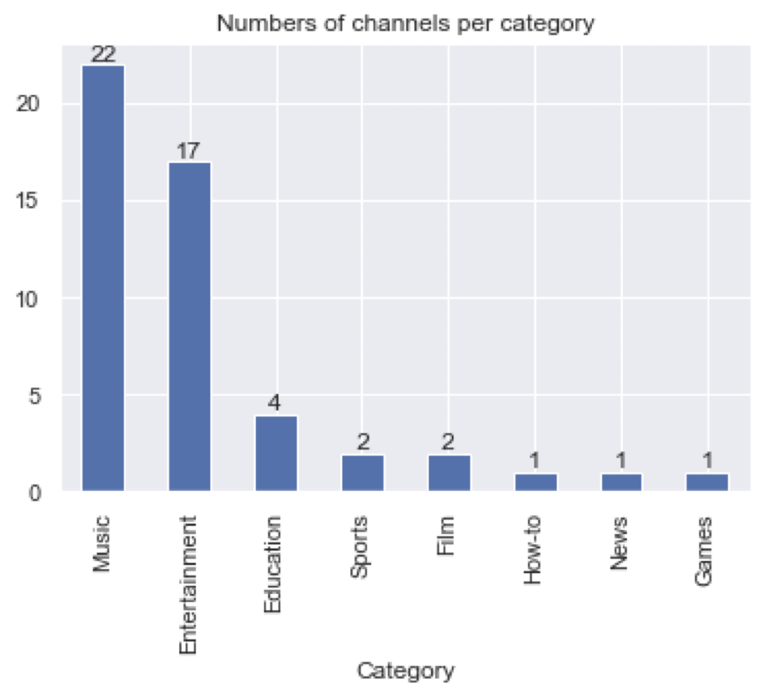
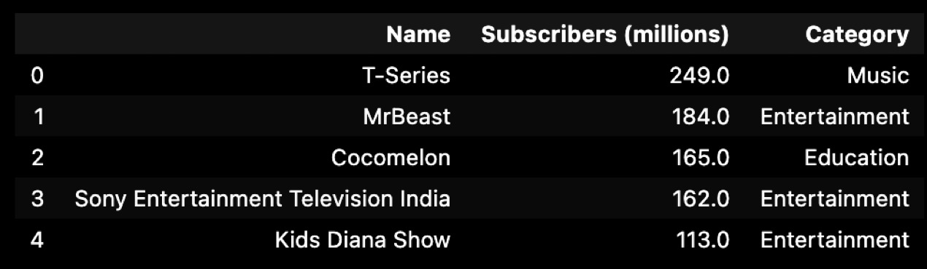
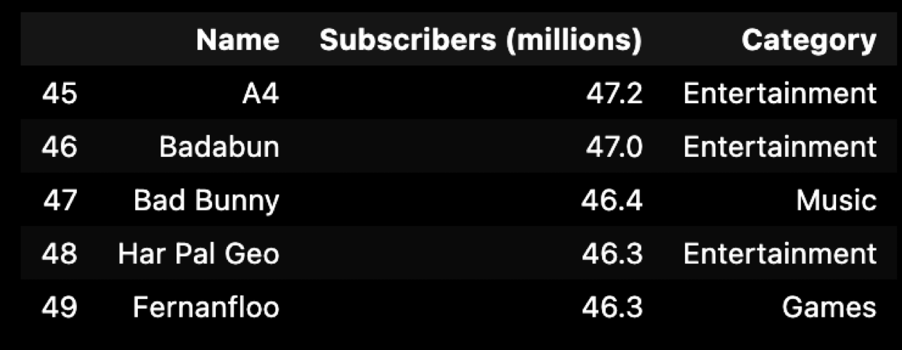
Category analysis:
- Entertainment and music categories dominate within the top 50 channels (78% of total subscribers), with the third largest category only covering 9%. Once again, we can observe unbalanced repartition.
- This phenomenon can be explained by this content being consumed passively (as background noise while performing tasks or working) while educational content needs to be seen by the viewer for context (tutorials, documentaries, online courses, and such)

Slide 6
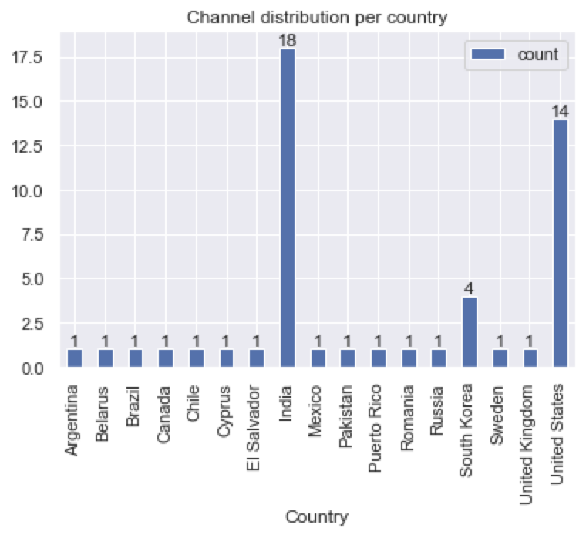
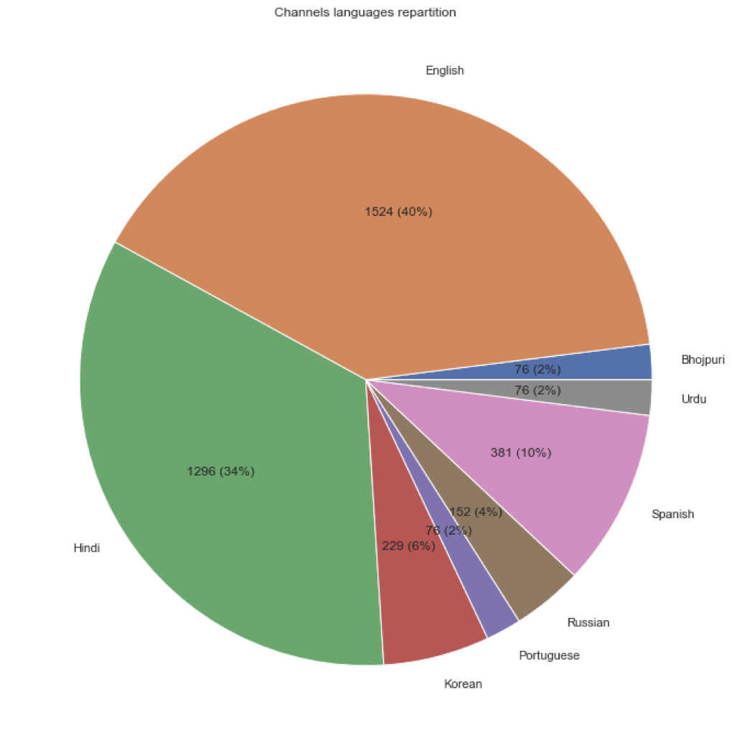
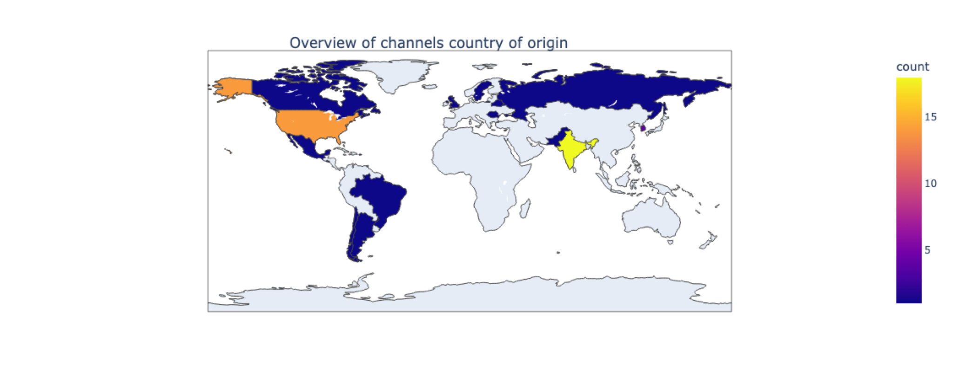
Geographic and Language distribution:
- India and USA have the most channels (18%,14%), followed by South Korea (4%).
- This previous statement can be justified by multiple facts. India, besides being the most populated country in the world, has a large proportion of its population being between 15 and 34 years old (34.5% of total Indian population. Furthermore, mobile data was drastically improved in rural areas, providing modest parts of this country with new technologies. We can also add that smart TVs are being democratized, offering a direct path to YouTube content. Lastly, YouTube is a free platform, motivating people to stray from cable TV, which sometimes requires a subscription.
- At the same time, the fact that the USA isn’t too far behind India despite having almost a quarter of its population can be attributed to its individualistic culture.
- As for languages, English comes first (40%), followed by Hindi (34%) and Spanish (10%). English can be considered a universal language since it is used in many fields and is the most spoken language worldwide. Hindi comes third, explaining the second language (Mandarin Chinese, the second language, is on Youku). Spanish is the fourth spoken language worldwide.

Slide 7
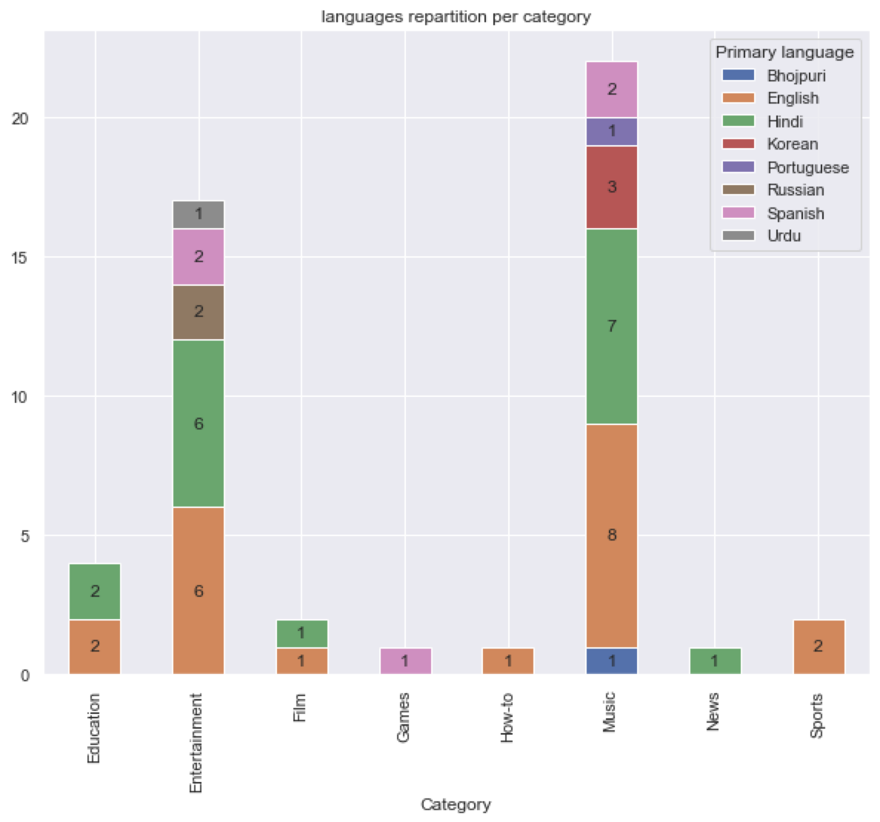
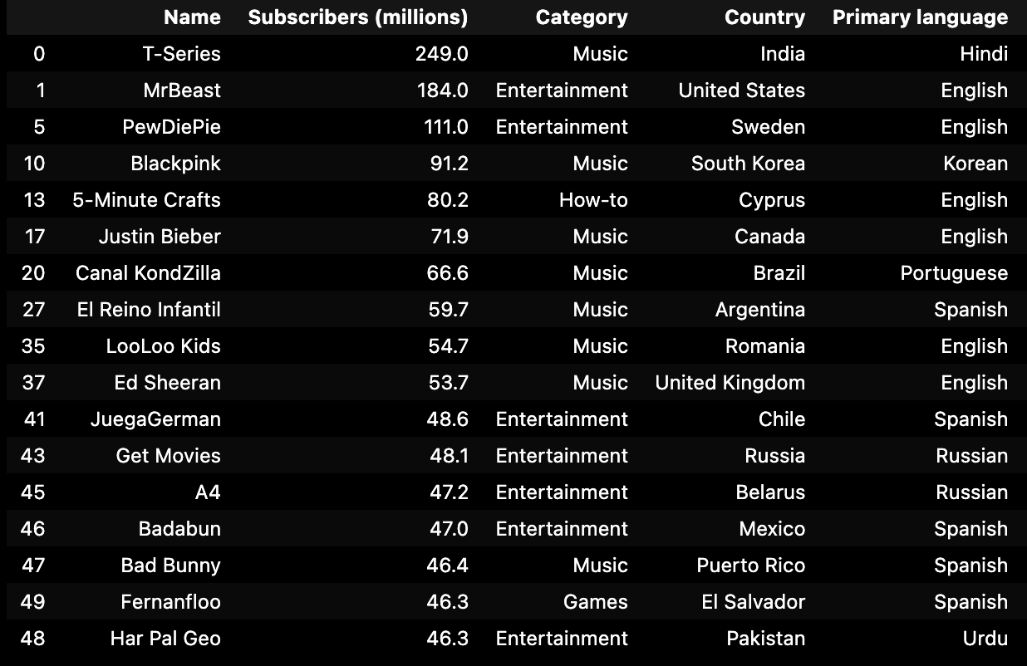
Language dominance per category:
- English is dominant in 3 categories and is tied in 3 categories with Hindi. Hindi is prevailing in just one category. We can also notice that some languages appear in just one category such as Korean, Portuguese, and Bhojpuri.
- English and Hindi being the only two languages in the film category can be explained by Hollywood and Bollywood making cinematography a big part of the cultures that are primary speakers of these languages.
Top channel per region
- Worldwide, 8 channels are Music related, 7 are Entertainment related while How-to and Games are represented by only one channel, showing once again that the music and entertainment industry is a large part of the top 50.
- We can also notice a few channels do not use their native language like Pewdiepie using English instead of Swedish. The main goal of this practice is to reach a wider audience by using a more widely known language than targeting a specific audience speaking a less spoken language.

Slide 8
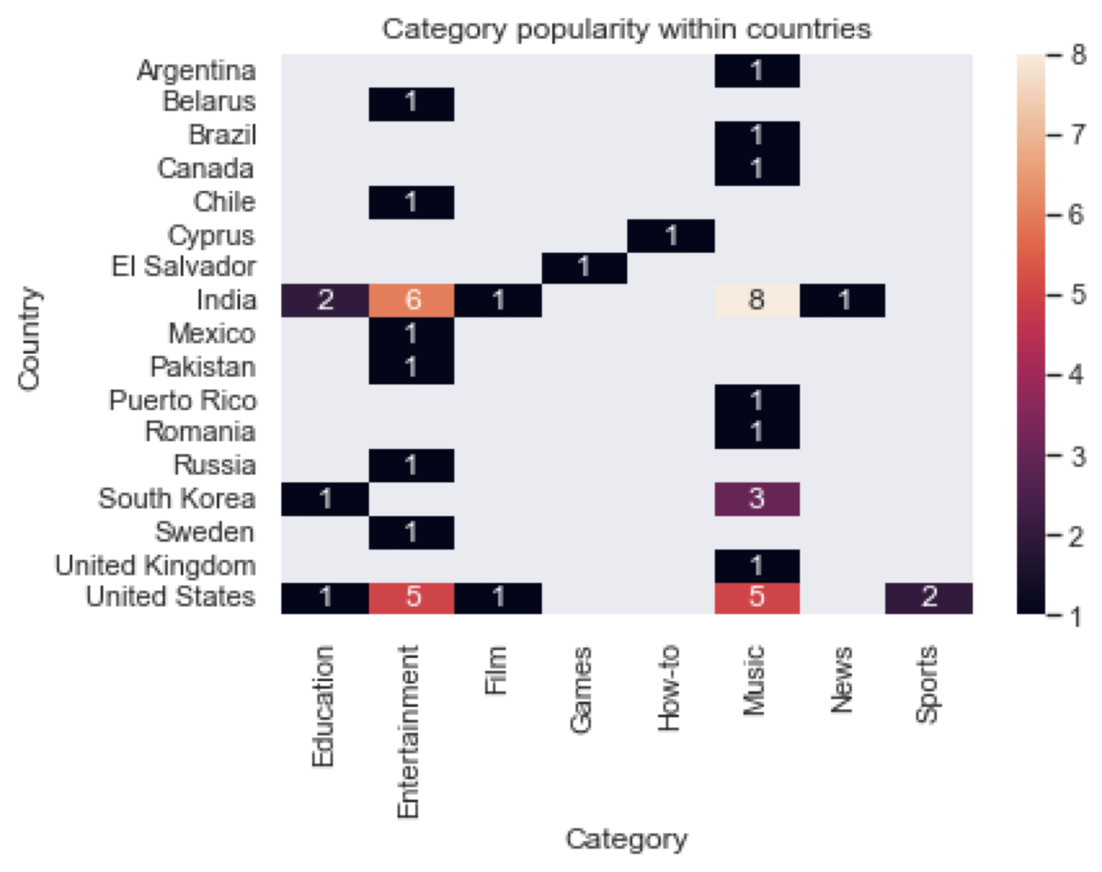
Advanced analysis
Trends analysis:
- Some countries have an important concentration on one or multiple categories. This can interpreted in several ways :
Those countries are leaders in this category (K-pop in South Korea for instance)
They have a well-established and healthy content creation system, encouraging new channels to be created and create content, adding their unique touch.
There is a large demand for those types of content in those countries, leading to these countries being content powerhouses in those categories.

Slide 9
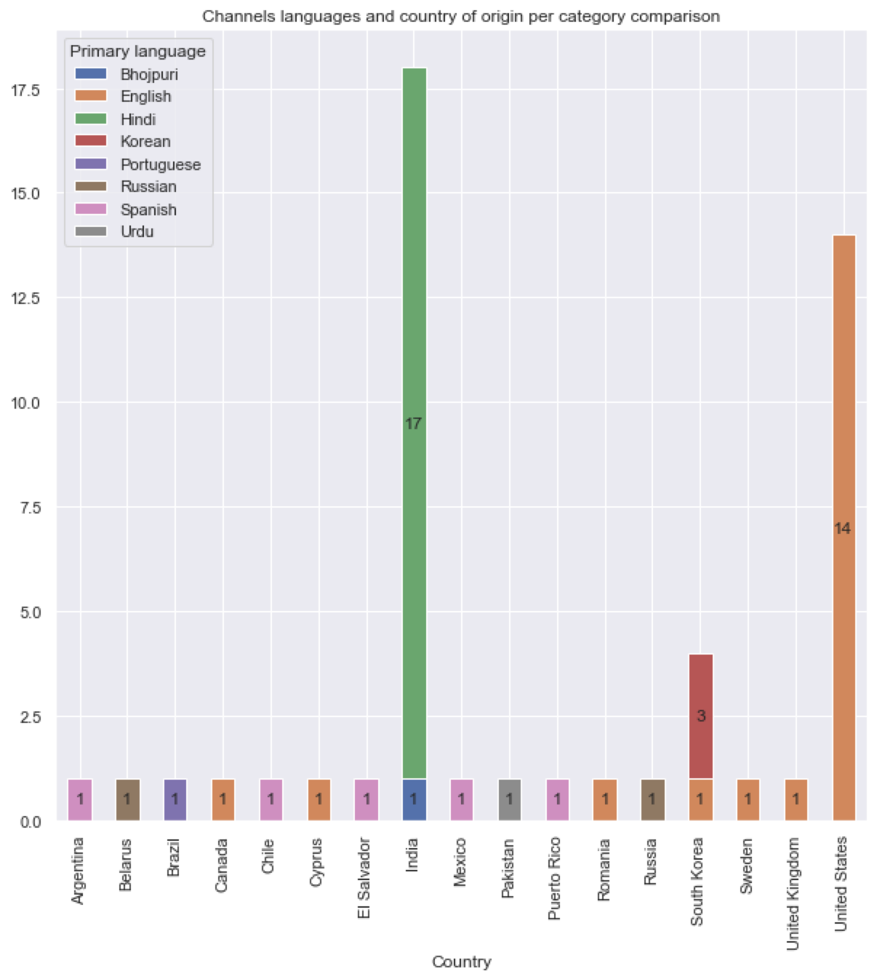
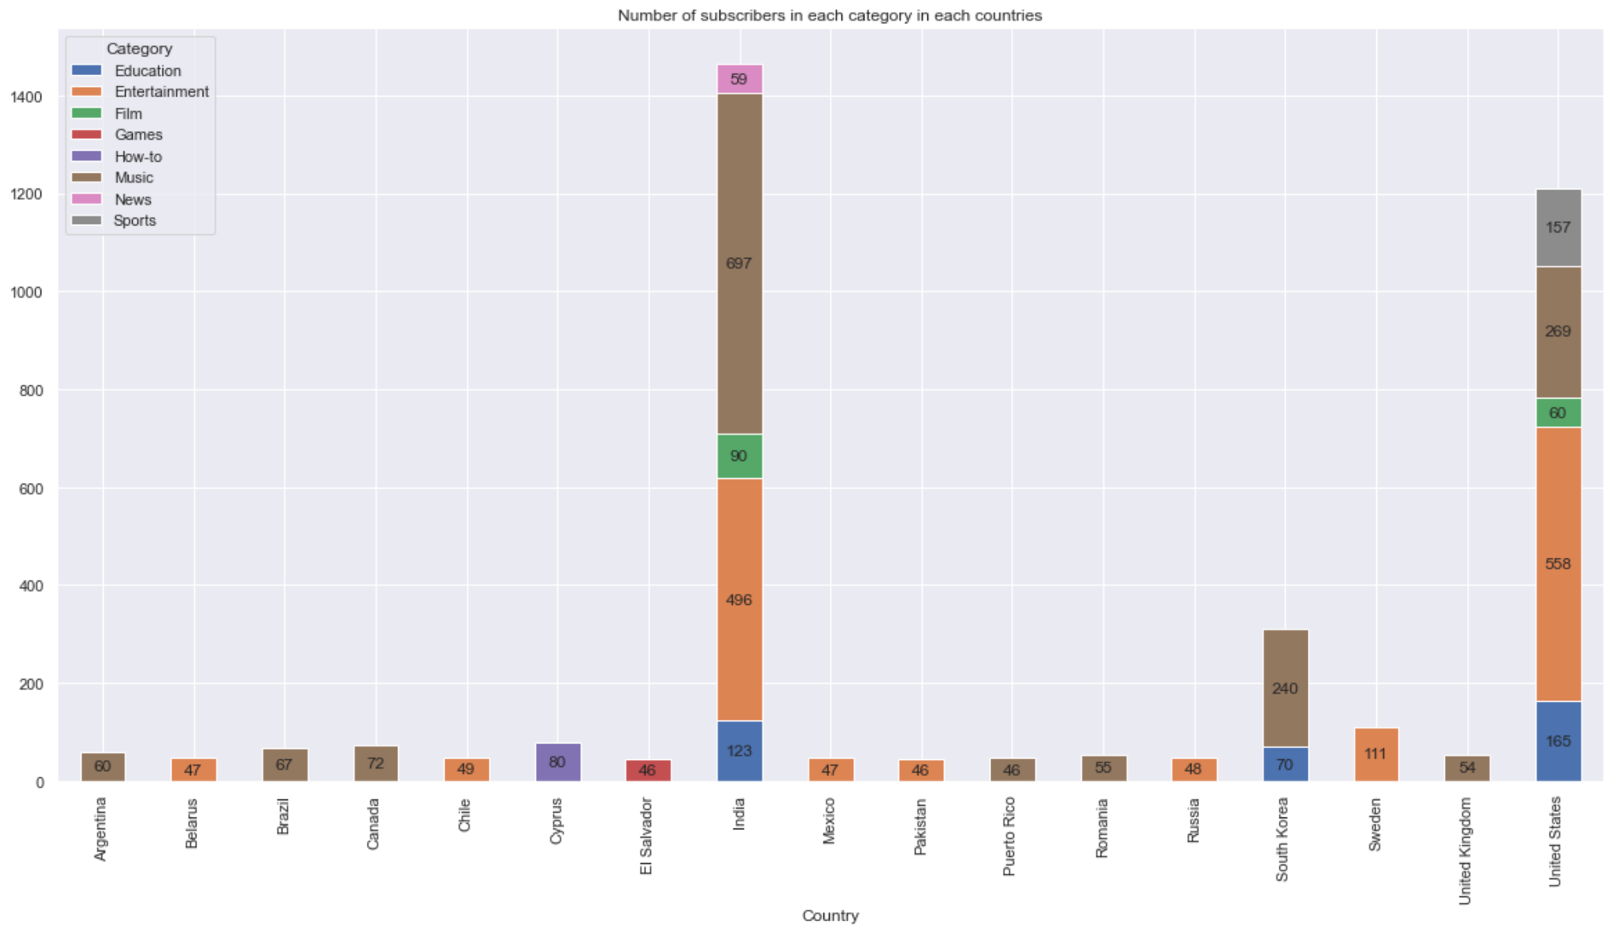
Country insights analysis
- We can see that some channels don't use their national language as their primary language such as some Indian channels using a dialect from North India, South Korean channels using English along with Korean or Swedish channels using exclusively English instead of Swedish, accentuating our point dealt in “top channel per region” part.
- We can also notice that a vast majority of countries tend to consume music and entertainment content, further supporting the theory about passive consumption of content.
- This also demonstrates how some channels cut out their niche by aiming for an audience that isn’t usually catered to within a category. E.g. Fernanfloo's fame in Latin America is due to his content targeting a Spanish-speaking audience within a gaming category, that is dominated by English-speaking channels.

Slide 10
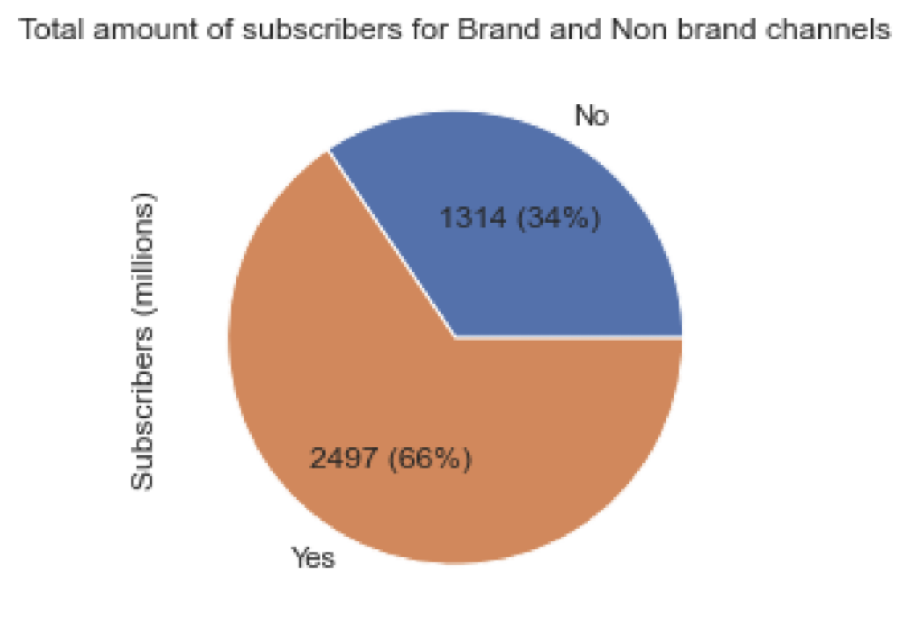
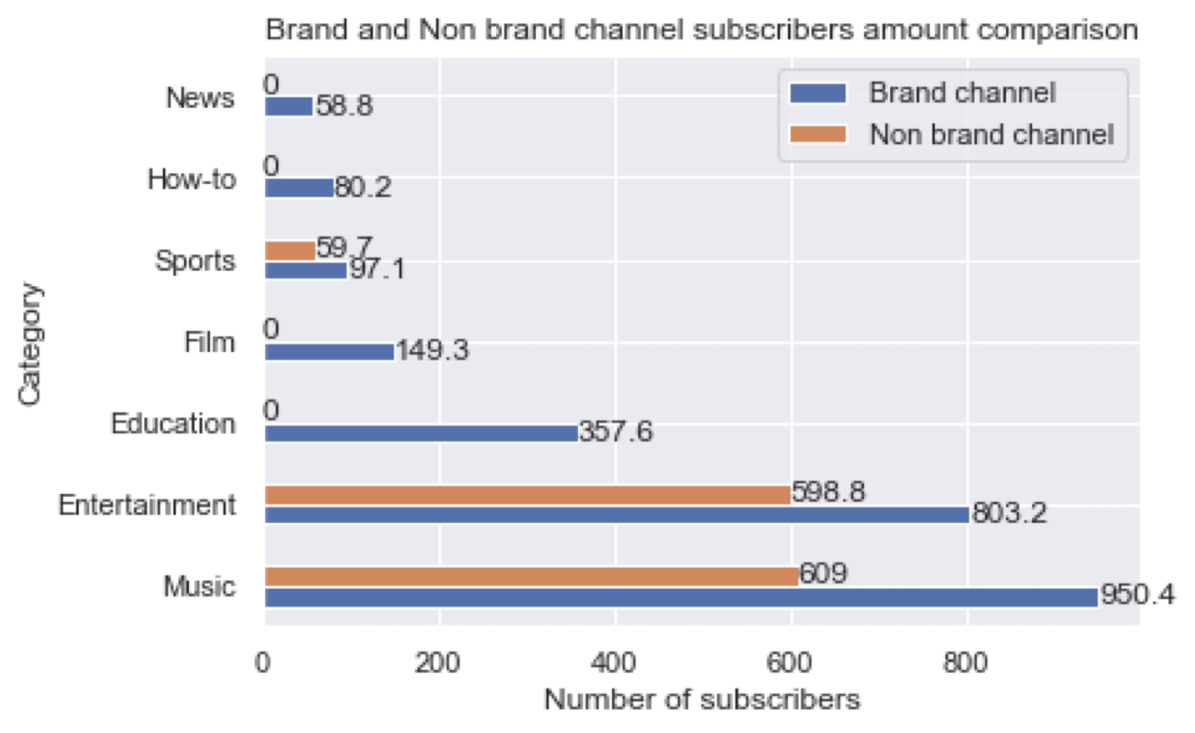
Subscribers distribution between Brand and non-brand channels
- Brand channels have more presence than non-brand channels, accumulating 66% of total subscribers. This difference can be explained by the fact brands have a lot of resources outside YouTube that can help boost their channel. E.g. an already-established brand, ability to hire celebrities, or professional video makers.
- Additionally, brand channels own a lot of the content from the most preferred categories such as Entertainment and Music(e.g. labels owning popular songs), which are subjected to passive consumption, which makes it easier to get views and subscribers.
- On the other hand, this amount of subscribers for the non-brand channels indicates that a specific audience has been satisfied, proving to us that some niche categories can have a certain appeal. It may also show as a token of recognition and content quality for personal content creators, who have fewer resources than brand channels.
Influence of brand channels in categories
- We can notice brand channels have a large presence in all categories, even completely dominating some of them. We can guess this difference is mostly because brand channels are composed of large corporations possessing a lot of resources and an already established reputation.
- Non-brand channel presence is mostly due to the content creator's authenticity, interaction with their community, and also their niche expertise. A faithful community helps the channel grow through word of mouth. YouTube algorithms can also favor non-brand channels if their community grows big.
- We can also add that certain categories are experiencing oversaturation, making it difficult for both brand and non-brand channels to grow (e.g.: Different music labels competing against each other).

Slide 11
Conclusion :
Our study of the top 50 most subscribed channels highlights some points showing how YouTube channels are successful.
- The subscriber base of these channels is not evenly distributed worldwide, with significant concentrations in India and the USA, followed by South Korea. This suggests that a country’s culture plays a role in a channel's success.
- Our examination of channel categories indicates a clear dominance of Entertainment and Music, followed far away by educational content. The subscriber distribution within these categories further emphasizes the appeal of passive consumption of content.
- Channels from different countries showcase large language preferences, which correlate with regional interests and cultural nuances. As an example, English-speaking channels dominate the global subscriber count, but content in a specific language such as Hindi or Spanish shows a region-specific content trend.
- Language usage per category illustrates that certain genres benefit from multilingual approaches, while others thrive in a single language. This points to the necessity for creators to tailor their content to fit both their target audience and their category.
- The identification of top channels by region reveals that successful channels often cater to specific local tastes, utilizing cultural references and trends to connect with their audiences. This localized approach enhances engagement and loyalty among subscribers.
- The analysis shows an uneven subscriber distribution between brand and non-brand channels, with brand channels often being the only contestant in some categories. Their influence shows they benefit from an already made renown, a customer-based community, or funds allowing them to detain exclusive content that will generate subscribers (label having a contract with a trendy artist).
- Besides this fact, non-brand channels coexist with professional content creators, suggesting that authenticity and connection with the channel’s community remain vital for success. Non-brand channels can thrive by establishing strong personal brands and engaging directly with their audiences.
In conclusion, the factors contributing to a YouTube channel's success in 2024 combine a mix of geographic, cultural, and content elements. Content creators must adapt to shifting viewer preferences and trends, prioritizing quality content, audience engagement, and strategic localization to ensure sustained growth and relevance in an ever-changing background.

